Slide 1
2009 H1N1
Overview of a Pandemic
April 2009 – August 2010
National Center for Immunization & Respiratory Diseases

Slide 2
Outline
Background on Influenza
Tracking Influenza
Preparing for a Pandemic
Detection of the 2009 H1N1 Virus
Impact of 2009 H1N1
2009 H1N1 Accomplishments
What You Can Do
Resources

Slide 3
Background on Influenza

Slide 4
What is Influenza?
Influenza (the flu) is a contagious respiratory illness caused by influenza viruses. It can cause mild to severe illness, and at times can lead to death

Slide 5
What are the Symptoms of Influenza?
Symptoms of influenza include the following:
Fever* or feeling feverish/chills
Cough
Sore throat
Runny or stuffy nose
Muscle or body aches
Headaches
Fatigue (tiredness)
Some people may have vomiting and diarrhea, though this is more common in children than adults.
* It's important to note that not everyone with flu will have a fever

Slide 6
How Influenza Spreads
People with flu can spread it to others up to about 6 feet away
Most experts think that flu viruses are spread mainly by droplets made when people with flu cough, sneeze or talk
These droplets can land in the mouths or noses of people who are nearby or possibly be inhaled into the lungs. (large droplet transmission, small particle droplet nuclei)
Less often, a person might also get flu by touching a surface or object that has flu virus on it and then touching their own mouth or nose (contact transmission)

Slide 7
Influenza Incubation Period
  1- 7 days (typically 2-3 days)
  Viral shedding can begin 1 day before illness onset
  This means that people can be contagious to others from the day before illness
  Most people will shed virus and possibly able to spread flu to others for 5-7 days after illness onset
  Children, severely ill persons, and those with weakened immune systems may shed virus for longer than 7 days

Slide 8
What is the Impact of Seasonal Influenza in the United States?
Flu seasons vary substantially from year to year
Difficult to predict severity or timing
5% - 20% of U.S. population infected
  Highest illness rates in children
  Highest complication rates in elderly
Annual estimated flu-associated deaths from 1976-2007 ranged from a low of about 3,000 deaths (1986-1987 season) to nearly 49,000 deaths (2003-2004 season)¹
About 90% of deaths occur among people 65 years of age and older²
Annual average of 220,000 hospitalizations – about 50% in 65 and older³
Influenza results in substantial economic impact – estimated at ~$37.5 billion⁴
1-2. CDC. Estimates of deaths associated with seasonal influenza --- United States, 1976—2007. MMWR 2010; 59:1057-1062.
3. Thompson WW, Shay DK, Weintraub E, et al. Influenza-associated hospitalizations in the United States. JAMA 2004; 292:1333-1340.
4. Molinari NM, Ortega-Sanchez, IR, Messonnier ML, et al. The annual impact of seasonal influenza in the US: Measuring disease burden and costs. Vaccine. 2007; 25: 5086–5096.

Slide 9
Groups at Increased Risk of Severe Influenza
Children younger than 5, but especially children younger than 2 years old
Adults 65 years of age and older
Pregnant women
Last flu season, American Indians and Alaskan Natives seemed to be at higher risk of flu complications
People who have medical conditions including:
  Asthma
  Neurological and neurodevelopmental conditions [including disorders of the brain, spinal cord, peripheral nerve, and muscle such as cerebral palsy, epilepsy (seizure disorders), stroke, intellectual disability (mental retardation), moderate to severe developmental delay, muscular dystrophy, or spinal cord injury].
  Chronic lung disease (such as chronic obstructive pulmonary disease [COPD] and cystic fibrosis)
  Heart disease (such as congenital heart disease, congestive heart failure and coronary artery disease)
  Blood disorders (such as sickle cell disease)
  Endocrine disorders (such as diabetes mellitus)
  Kidney disorders
  Liver disorders
  Metabolic disorders (such as inherited metabolic disorders and mitochondrial disorders)
  Weakened immune system due to disease or medication (such as people with HIV or AIDS, or cancer, or those on chronic steroids)
  People younger than 19 years of age who are receiving long-term aspirin therapy
  People who are morbidly obese (Body Mass Index, or BMI, of 40 or greater)

Slide 10
Influenza Viruses
There are three main types of influenza (flu) virus: Types A, B and C
Human influenza A and B viruses cause seasonal epidemics of disease almost every winter in the United States
Influenza type C infections cause a mild respiratory illness and are not thought to cause epidemics
Influenza A viruses are divided into subtypes based on two proteins on the surface of the virus: the hemagglutinin (H) and the neuraminidase (N)
Influenza B viruses are not divided into subtypes. Influenza B viruses also can be further broken down into different strains

Slide 11
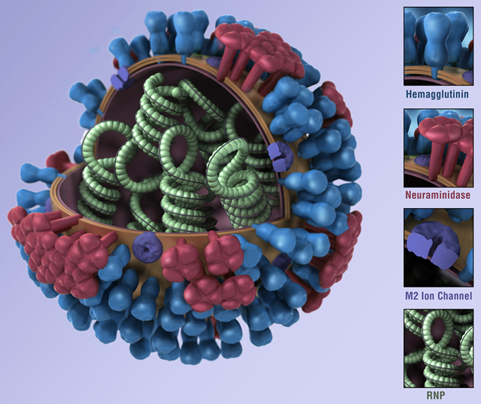
Key Influenza Viral Features
Surface proteins (major antigens)
Hemagglutinin (HA)
HA attaches virus to host cells
Antibody to HA is protective
Neuraminadase (NA)
Helps release virions from cells
Antibody to NA can help modify disease severity
M2 Ion Channel
Proton-selective ion channel
Lowers the pH inside of the virus resulting in dissociation of the RNPs from the matrix protein (M1)
Ribonucleoprotein (RNP)
RNA segment packaged in nucleoprotein
An independent transcription active unit (containing a polymerase complex, consisting of PA, PB1 and PB2

Slide 12
Influenza Viruses
Current subtypes of influenza A viruses found in people are influenza A (H1N1) and influenza A (H3N2) viruses
Influenza A (H3N2) viruses cause the greatest morbidity, mortality
Influenza A (H1N1), A (H3N2), and influenza B viruses are included in each year’s influenza vaccine

Slide 13
Influenza: An Ever-Changing Virus
Influenza (flu) viruses can change in two different ways: antigenic drift and antigenic shift
Antigenic drift:
Refers to small changes in influenza viruses that happen continually over time
Is one of the main reasons why people can get the flu more than one time
  A person infected with a particular flu virus strain develops antibody against that virus. As newer virus strains appear, the antibodies against the older strains no longer recognize the "newer" virus, and re-infection can occur
In most years, one or two of the three virus strains in the influenza vaccine are updated to keep up with the changes in the circulating flu viruses

Slide 14
Influenza: An Ever-Changing Virus
The other way influenza viruses change is through “antigenic shift”
Antigenic shift:
Is an abrupt, major change in the influenza A viruses
Results in a new influenza A subtype or a virus with a hemagglutinin or a hemagglutinin and neuraminidase combination that has emerged from an animal population that is so different from the same subtype in humans that most people do not have immunity to the new (e.g. novel) virus
An example of a “shift” occurred in the spring of 2009, when a new H1N1 virus with a new combination of genes (from American pigs, Eurasian pigs, birds and humans) emerged in people and quickly spread, causing a pandemic
Although influenza viruses are changing by antigenic drift all the time, antigenic shift happens only occasionally

Slide 15
Tracking Influenza

Slide 16
Why do we want to track influenza?
Characterize circulating viruses
Determine where influenza is spreading
Determine to whom influenza is spreading
Describe those at risk of severe disease
Describe the spectrum of clinical illness
Identify viruses with pandemic potential
Goal: Make best recommendations for prevention and control

Slide 17
Key Indicators
Influenza activity is monitored by various approaches, primarily with key indicators:
  Virus characteristics
  Geographic spread
  Outpatient illness reports
  Hospitalizations
  Deaths

Slide 18
Virus Surveillance
Reports from surveillance partners in clinical settings
  Participants in the National Respiratory and Enteric Viruses Surveillance System (NREVSS)
  Generally indicate if influenza A or B
Reports from Public Health Labs participating in CDC’s part of the WHO Global Influenza Surveillance Network. These laboratories report on type and subtype:
  Influenza B
  Influenza A
    Seasonal H1, H3, 2009/H1
    Unsubtypable A – requires immediate report

Slide 19
Virus Surveillance
CDC supports 95 U.S. public health and reference laboratories with staff, equipment, and reagents
CDC maintains an “Influenza Reagent Resource” to manufacture and distribute test reagents for U.S. and over 140 countries
System monitors for antiviral resistance, genetic mutations, and for vaccine match
CDC has continuous development of new and updated diagnostic tests for improved detection

Slide 20
Disease Surveillance
Disease surveillance monitors:
  Geographic spread of disease in the community
  Where and when the flu is showing up in clinics and emergency departments
  In hospitals, the severity, clinical illness, and those at risk
  Mortality via death reports

Slide 21
Summary of the Geographic Spread of Influenza
State and Territorial Epidemiologists Reports – State health departments report the estimated level of spread of influenza activity in their states each week
States report influenza activity as no activity, sporadic, local, regional, or widespread

Slide 22
Outpatient Illness Surveillance
The Outpatient Influenza-like Illness Surveillance Network (ILINet) consists of more than 3,000 healthcare providers in all 50 states, the District of Columbia and the U.S. Virgin Islands reporting over 25 million patient visits each year
Approximately 1,400 outpatient care sites around the country report weekly data to CDC on the total number of patients seen and the number of those patients with influenza-like illness (ILI) by age group

Slide 23
Hospitalization Surveillance – Emerging Infections Program (EIP)
The EIP Influenza Project conducts surveillance for laboratory-confirmed influenza related hospitalizations in children and adults in 60 counties covering 12 metropolitan areas of 10 states (San Francisco CA, Denver CO, New Haven CT, Atlanta GA, Baltimore MD, Minneapolis/St. Paul MN, Albuquerque NM, Las Cruces, NM, Albany NY, Rochester NY, Portland OR, and Nashville TN)
Cases are identified by reviewing hospital laboratory and admission databases and infection control logs for children and adults with a documented positive influenza test. EIP estimated hospitalization rates are reported every other week during the influenza season, but were reported weekly during the 2009 H1N1 pandemic

Slide 24
Mortality Surveillance
122 Cities Mortality Reporting System Information on patient visits to health care providers for influenza-like illness is collected through the US Outpatient Influenza-like Illness Surveillance Network (ILINet)
Surveillance for Influenza-associated Pediatric MortalityInfluenza-associated deaths in children (persons less than 18 years) was added as nationally notifiable condition in 2004. Laboratory-confirmed influenza-associated deaths in children are reported through the Influenza-Associated Pediatric Mortality Surveillance System

Slide 25
Preparing for a Pandemic

Slide 26
Preparing for a Pandemic
Pandemics are sporadic, unpredictable
Caused by novel influenza A viruses
Spread from person to person and cause human illness
Most of the population is susceptible

Slide 27
Preparing for a Pandemic
Three conditions must be met for a pandemic to start:
A new influenza virus subtype must emerge for which there is little or no human immunity;
It must infect humans and causes illness; and
It must spread easily and sustainably (continue without interruption) among humans

Slide 28
Preparing for a Pandemic
Assumptions
The threat of an avian influenza A (H5N1) pandemic shaped some assumptions
  pandemic virus would likely emerge in birds, not swine
  pandemic virus would likely emerge in Southeast Asia, not North America
Planned for a worst case scenario – Severity of 1918, not 1968
Planning for a severe pandemic provided opportunities to improve epidemiology and laboratory capacity
  Better lab and epidemiologic surveillance
  New reporting requirements by WHO and CDC

Slide 29
Actions for Diagnostic Preparedness
Develop New Diagnostic Tests and Improved Diagnostic Capabilities
Improve Surge Capacity
Implement Proficiency Testing
Increase Laboratory Training
Develop Policy and Regulatory Preparedness
Improve Access to Viruses and Reagents
Provide Guidance for Clinicians
Improve Virologic Surveillance
Conduct Antiviral Resistance Testing

Slide 30
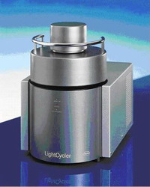

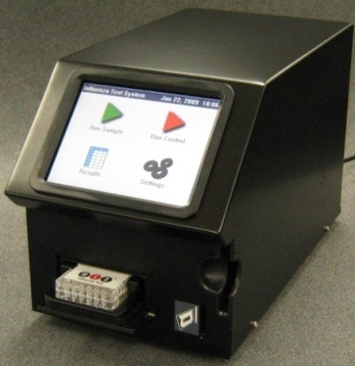
Enhanced Laboratory Detection
Developed New Diagnostic Tests
  2007 - PCR Test for detecting avian influenza A (H5) viruses on “LightCycler”
  2008 - PCR Test for detecting A, B, H1, H3, and H5 on “AB 7500”
  2008 - Experimental Point of Care Test on “Mesoscale Diagnostics” device

Slide 31

Enhanced Virus Surveillance
Increased number of labs in US with testing devices, staff, and reagents
Increased number of specimens being tested
Developed “Influenza Reagent Resource”
  Contract laboratory to manufacture and distribute PCR reagents during routine seasons
  Rapidly makes reagents during a pandemic surge
www.InfluenzaReagentResource.org
Fluorder@cdc.gov

Slide 32
Increasing Detection of Swine Influenza
Increasing numbers of cases of swine influenza being detected NEJM 2009 Shinde et al.
  Due to increased public health laboratory testing
  Few number of cases
    1-2 per year until 2005
    11 total from 2006 to Feb 2009
  Limited transmission among cases
  Most with some connection to swine exposure
Increasing efforts among government agencies in U.S. to investigate human cases of swine flu

Slide 33
Detection of
2009 H1N1 Virus

Slide 34
Detection of 2009 H1N1 Virus
March 2009
  2 cases of febrile respiratory illness in children (un-related, no pig contact)
  Residents of adjacent counties in southern California, ill in late March
2009 pandemic influenza A (H1N1) virus testing began at CDC on April 15th
Both viruses genetically identical
  Contain a unique combination of gene segments previously not recognized among swine or human influenza viruses in the United States
Retrospective evidence of respiratory illness outbreaks in Mexico (February/March)
April 26, 2009
U.S. declares National Public Health Emergency
June 11, 2009
WHO declares Global pandemic of novel influenza A (H1N1) virus

Slide 35


Novel Swine Influenza Detected
1) April 15, 2009
  10-year-old boy
  Mild flu symptoms
  Part of CDC study using “Mesoscale” flu test
2) April 17, 2009
  8-year-old girl
  Mild flu symptoms
  Part of CDC Border Influenza Project
Surveillance showed no other novel flu cases
No suspect flu cases in hospitals in the region
1
2
Southern California, US

Slide 36
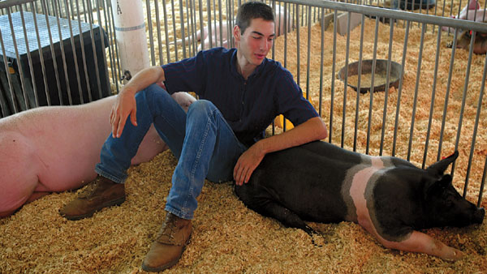
Novel Swine Influenza Detected
Both cases reported in MMWR - MMWR 58(15);400-02
Posted gene sequences on GenBank
Searched for swine exposure
  10 year old visited San Diego zoo
  8 year old at county fair
No evidence to link to swine
Contestant at County Fair in California

Slide 37
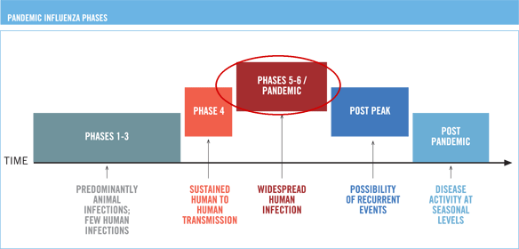
June 11, 2009
“On the basis of available evidence, and these expert assessments of the evidence, the scientific criteria for an influenza pandemic have been met. I have therefore decided to raise the level of influenza pandemic alert from phase 5 to phase 6. The world is now at the start of the 2009 influenza pandemic.”
- Dr Margaret Chan, Director-General of the World Health
Organization

Slide 38
Surveillance Systems
As the outbreak investigation expanded, CDC epidemiologists worked with state, local and international partners to enhance CDC’s existing flu surveillance systems to better track the spread of 2009 H1N1

Slide 39
Impact of 2009 H1N1

Slide 40
Impact of 2009 H1N1 Flu
Global Impact
  More than 214 countries and overseas territories or communities had reported laboratory confirmed cases of pandemic influenza H1N1 2009, including at least 18,449 deaths (World Health Organization, August 6, 2010)
  Reported cases and deaths are likely a substantial under-estimate of true impact of 2009 H1N1
  Estimating the true number of individual flu cases and deaths is very challenging
    Many people with flu don’t seek medical care
    Only a small number of those that do seek care are tested
    More people who are hospitalized or die of flu-related causes are tested and reported, but under-reporting of hospitalizations and deaths occurs as well

Slide 41
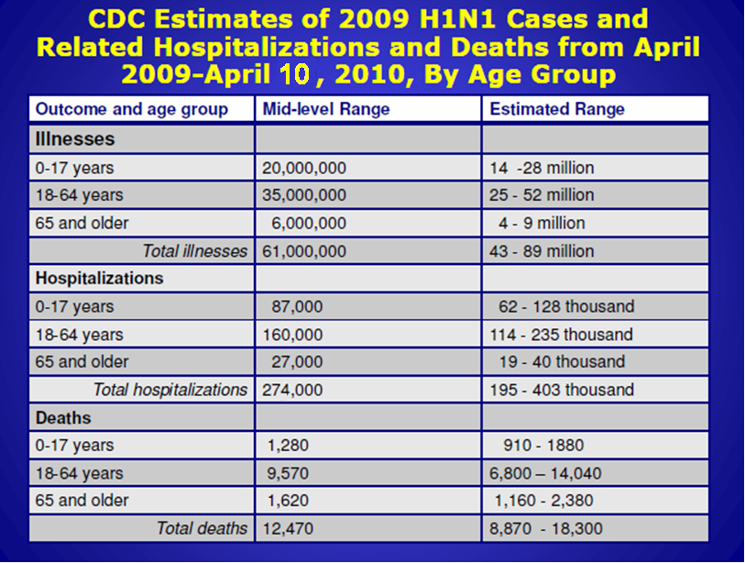
Impact of 2009 H1N1 Flu
Domestic Impact
http://www.cdc.gov/h1n1flu/estimates_2009_h1n1.htm

Slide 42
Characteristics of 2009 H1N1 Influenza
April 15, 2009 to April 10, 2010
Deaths
12,470
Hospitalizations
274,000
Approximate Rate per 100,000 population
Cases
61,000,000
0-4
5-24
25-49
50-64
≥65

Slide 43
Groups at Increased Risk of Severe Influenza (2009 H1N1)
Most impacted populations
  Children, young adults
  Persons with underlying chronic medical conditions (e.g. chronic lung disease, heart disease, immunosuppression, neurological and neurodevelopment diseases)
  Pregnant women
  Indigenous populations
Possible risk groups
  Obesity (Body Mass Index ≥35), Extreme/Morbid obesity (Body Mass Index ≥40)

Slide 44
2009 H1N1 Hospitalizations
Frequency of Underlying Conditions in Adults
EIP April 15, 2009 – February 16, 2010 (n=4,987)
85% of adults with underlying condition

Slide 45
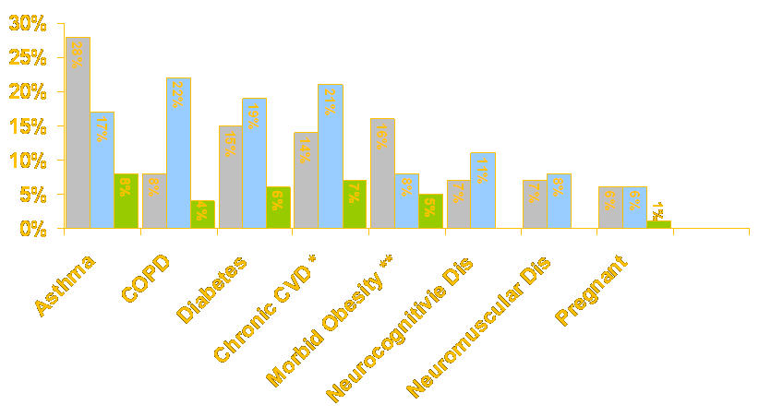
Underlying conditions among hospitalized patients and those who died from H1N1 compared to the general population
Prevalence, 2009 H1N1 Hospitalizations
Prevalence, 2009 H1N1 Deaths
Prevalence, General US Pop
*Excludes hypertension
** Morbid obesity is defined as BMI of 40 or higher. For Hospitalized H1N1 patients, BMI calculation was performed on non-pregnant adults ≥ 20 years (n=119). 45% of 119 non-pregnant hospitalized adults ≥ 20 years were missing height and weight information. For Novel H1N1 Deaths, morbid obesity % was calculated for adults only. Prevalence for US non-pregnant adults is based on NHANES (JAMA. 2006;295(13):1577)
Source O Morgan, et al.

Slide 46
Obesity: a New Risk Factor for Severe Illness due to 2009 H1N1
Disproportionate number of obese, particularly morbidly obese, among severely ill during 2009 H1N1 pandemic
Morbid obesity (BMI≥40) was associated with hospitalization, and possibly death, due to 2009 H1N1 infection among adults without chronic medical conditions
Additional studies with larger sample of patients and appropriate comparison groups are needed
Morgan OW, Bramley A, et al. (2010)
PLoS ONE 5(3): e9694. doi:10.1371/journal.pone.0009694

Slide 47
Age-adjusted and Season-specific 2009 H1N1 Influenza-related Hospitalization Rates (per 100,000) by race & ethnicity –
Emerging Infections Program, 2009-10
Race/Ethnicity | Influenza Season
 | 2009 | 2009-10
White, non-Hispanic | 3.0 | 16.3
Black, non-Hispanic | 10.9 | 29.7
Hispanic | 8.2 | 30.7
Asian/Pacific Islander | 8.1 | 12.5
American Indian/Alaska Native | 4.1 | 32.7
2009: April 15 - August 31, 2009
2009-10: September 1, 2009 - January 26, 2010

Slide 48
2009 H1N1 Cumulative Lab-Confirmed Death Rate, by Age Group – April 2009 through March 27, 2010
Cumulative Lab-Confirmed Death Rate by Age Group (n=2,689)
Deaths per 100,000 Population

Slide 49
2009 H1N1 Accomplishments

Slide 50
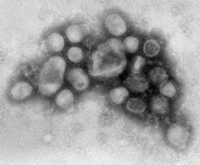
2009 H1N1 Accomplishments
CDC’s Influenza Division laboratories in Atlanta were the first in the world to identify the new 2009 H1N1 virus strain
CDC’s testing revealed that 2009 H1N1 was a new (novel) influenza virus strain that had not been previously detected in humans or animals
Accomplishments – p1

Slide 51
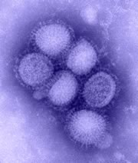
2009 H1N1 Accomplishments
The new 2009 H1N1 virus was originally referred to as “swine flu” because initial laboratory tests at CDC showed that six of the virus’s eight genes were most closely related to influenza viruses that normally occur in pigs in North America, and the remaining two genes were most closely related to influenza viruses circulating in Eurasian pigs
CDC uploaded the complete gene sequences of the 2009 H1N1 Virus to a publicly-accessible international influenza database, which enabled scientists around the world to use the sequences for public health research and for comparison against influenza viruses collected elsewhere
Accomplishments – p2

Slide 52
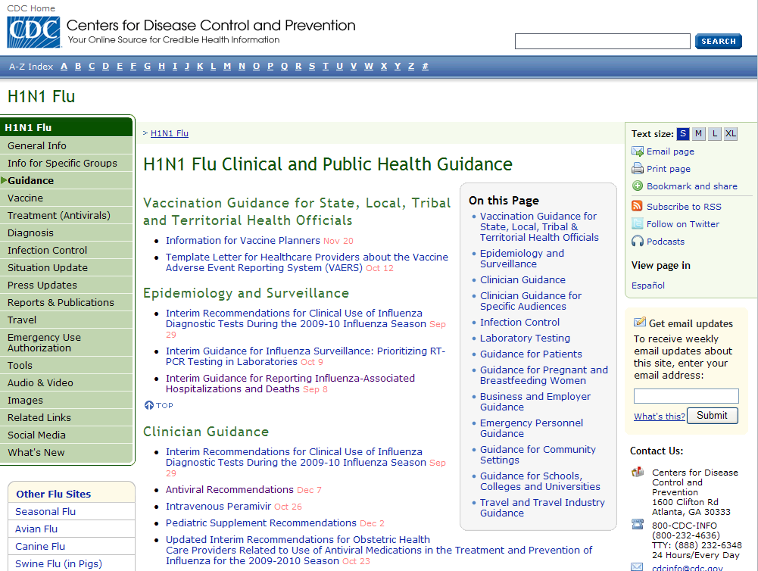
2009 H1N1 Accomplishments
CDC’s subject matter experts worked around the clock to create guidance documents for the general public, business, schools, child care programs, at-risk populations, clinicians, travelers, laboratory specialists, etc
Many of these documents were revised several times as the outbreak developed and as new information became available
Accomplishments – p4

Slide 53
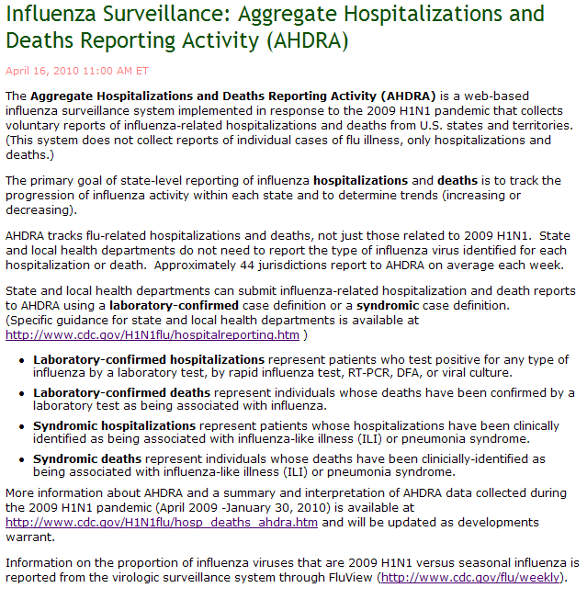
2009 H1N1 Accomplishments
Once the 2009 H1N1 outbreak was detected, CDC enhanced its existing surveillance systems and added several new surveillance systems to better track the spread, disease characteristics and burden of the new virus
One of the new surveillance systems was the Aggregate Hospitalizations and Deaths Reporting Activity (AHDRA), which was a Web-based system used to track state reports of laboratory-confirmed and syndromic flu-related hospitalizations and deaths
Because experts acknowledged that individual reports of hospitalizations
and deaths likely represented an undercount of what was occurring in
actuality, CDC also developed a method to estimate 2009 H1N1 cases,
hospitalizations and deaths in the United States. The methodology to derive
these estimates was based in part on extrapolation from AHDRA data
Accomplishments – p5

Slide 54
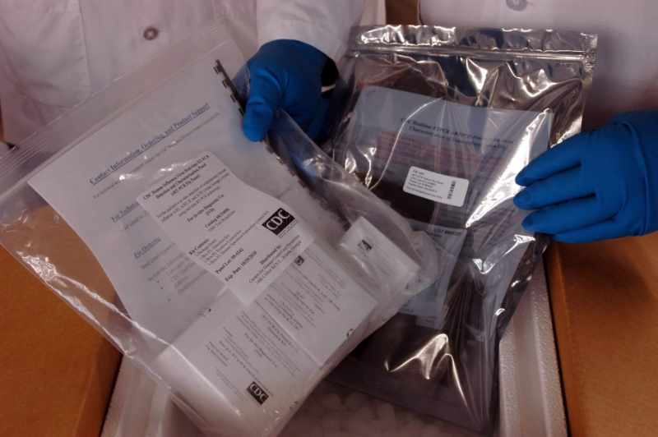
2009 H1N1 Accomplishments
CDC laboratory experts quickly developed primers and probes that could be incorporated into previously manufactured tests to identify the 2009 H1N1 Virus in respiratory (nose, throat and lung) samples collected from patients with 2009 H1N1 illness
Expedited FDA approval of an emergency use authorization (EUA) for these 2009 H1N1 diagnostic tests occurred on April 28, 2009, less than two weeks after identification of the 2009 H1N1 strain
On May 1, 2009, CDC test kits began shipping to domestic and international public health laboratories. As of August 2010, 2,344 RT-PCR test kits have been shipped to 442 labs in 145 countries and 305 WHO HI test kits have been shipped to 207 labs in 99 countries
Accomplishments – p6

Slide 55
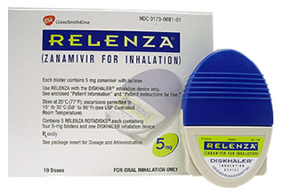
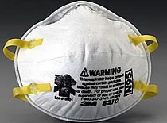

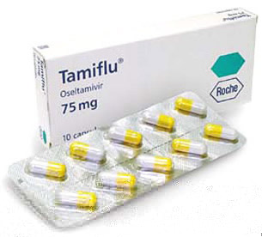
2009 H1N1 Accomplishments
In response to Secretary of Heath and Human Services (HHS) Kathleen Sebelius’ declaration of a public health emergency involving 2009 H1N1 flu on April 26, 2009, the FDA authorized the emergency use of important medical products under certain circumstances
FDA issued EUAs on the five medical products CDC requested, which allowed for the emergency use of antiviral products (Relenza and Tamiflu), certain types/models of N95 respirators, the rRT-PCR Swine Flu Panel diagnostic test, and the rRT-PCR Flu Panel (NPS, NS, TS, NPS/TS, NA) diagnostic test
Accomplishments – p7

Slide 56

2009 H1N1 Accomplishments
One of the most important laboratory activities performed at CDC was the selection and development of a candidate vaccine virus for use in the 2009 H1N1 vaccine
CDC’s laboratories took the first step of picking a candidate vaccine virus, which involves choosing a 2009 H1N1 virus that can be grown in mass quantities in chicken eggs
Once the virus is grown in mass quantities, the parts of the virus that are important for forming an immune response to the vaccine (the virus antigens), are purified to make the vaccine
Accomplishments – p8

Slide 57
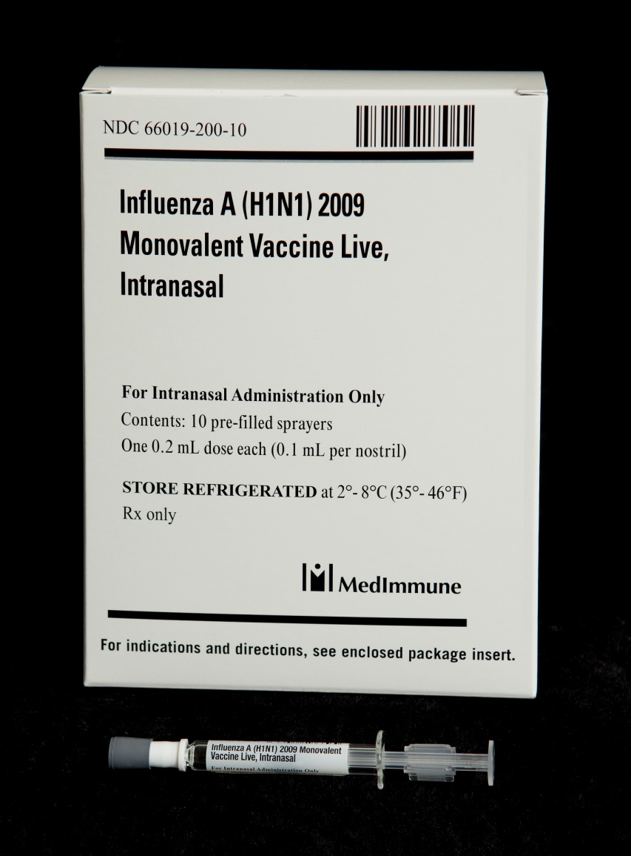
2009 H1N1 Accomplishments
CDC pursued several scientific methods to create a high-yield vaccine candidate virus for the 2009 H1N1 vaccine, and after consultation with WHO and the Food and Drug Administration (FDA), the A/California/7/2009 virus – a virus isolated at CDC – was chosen to be the vaccine candidate strain for making the 2009 H1N1 vaccine
After the virus was ready on April 27, 2009, CDC began sending it to vaccine manufacturing companies to begin the process of mass producing a vaccine to protect people against 2009 H1N1
The 2009 H1N1 vaccine was made using the same egg-based manufacturing process used for making the seasonal flu vaccine. These techniques have been used to reliably produce safe flu vaccines for decades
Accomplishments – p9

Slide 58
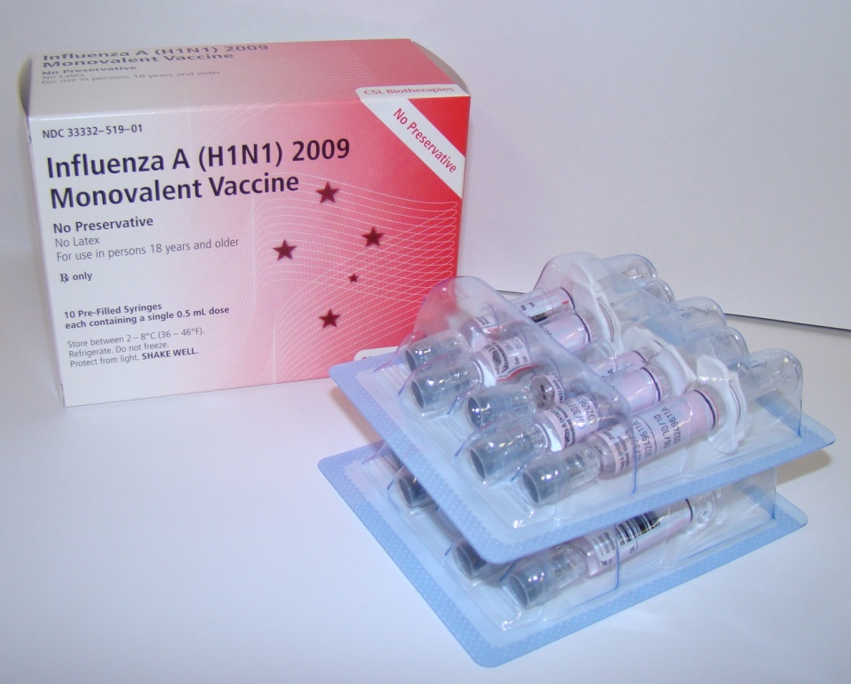
2009 H1N1 Accomplishments
The vaccine strain grew slowly in chicken eggs, resulting in delays in availability of initial lots of the vaccine. This led to some frustration on the part of the public during the early part of the fall wave of the pandemic, when vaccine supplies were limited
Despite the delays, the 2009 H1N1 vaccine was made available in near-record time, considering current technological limitations
Accomplishments – p10

Slide 59
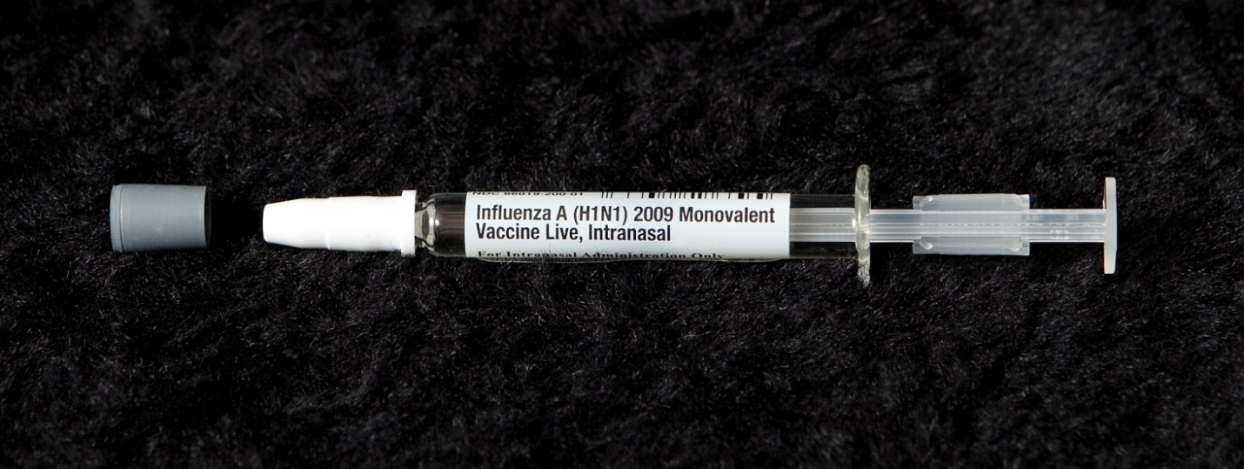
2009 H1N1 Accomplishments
In order to best allocate the initially limited supplies of vaccine, the Advisory Committee on Immunization Practices (ACIP), an independent body of experts that makes vaccine recommendations to CDC, designated target groups to receive the initial doses of the vaccine
Accomplishments – p11

Slide 60
2009 H1N1 Accomplishments
Initial priority groups
  Pregnant women
  Persons who live with or provide care for infants < 6 months (e.g., parents, siblings, and daycare providers)
  Healthcare and emergency medical services personnel
  Persons aged 6 months – 24 years
  Persons aged 25 – 64 years who have medical conditions that put them at higher risk for influenza-related complications
When vaccine became widely available
  Anyone aged 6 months and older, including persons 65 years and older
Accomplishments – p12

Slide 61
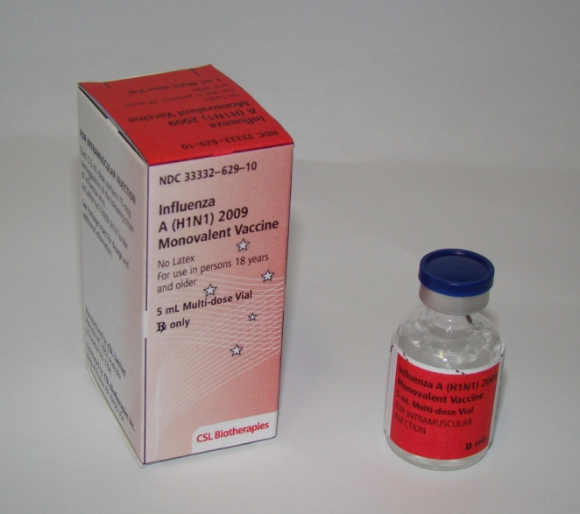

2009 H1N1 Accomplishments
The CDC’s distribution system used to supply vaccine to children through the Vaccines for Children Program was modified and enhanced to speed up delivery of the 2009 H1N1 vaccine
2009 H1N1 vaccine was sent to more than 70,000 direct-ship-to sites across the United States, and CDC estimates that over 116,000 providers signed agreements to receive vaccine and 10,000 retail pharmacy stores received the 2009 H1N1 influenza vaccine
As of April 2010, more than of 120 million doses of 2009 H1N1 vaccine had been shipped
Although each state approached 2009 H1N1 influenza vaccination efforts differently and vaccination rates varied across the United States, school-based vaccination program served as one successful strategy
Accomplishments – p13

Slide 62
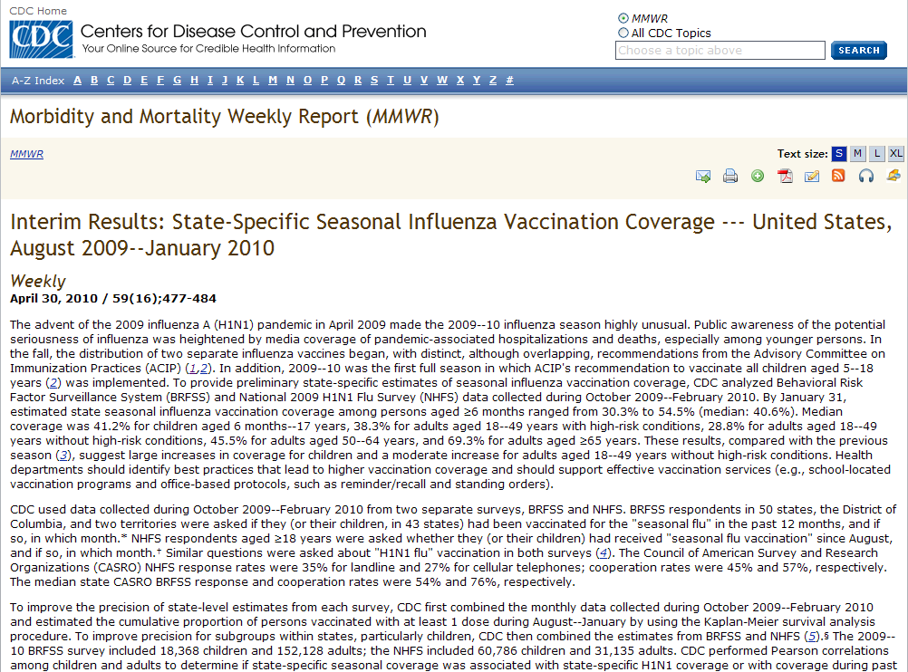
2009 H1N1 Accomplishments
Based on data from the Behavioral Risk Factor Surveillance System (BRFSS) and the National 2009 H1N1 Flu Survey (NHFS) combined, as of the end of February 2010, between 72-81 million people reported having been vaccinated against 2009 H1N1 flu
Preliminary analysis showed vaccination coverage was higher among children than adults and that more than two-thirds of those who received the 2009 H1N1 flu vaccine were in the initial target groups recommended by the ACIP
Accomplishments – p14

Slide 63
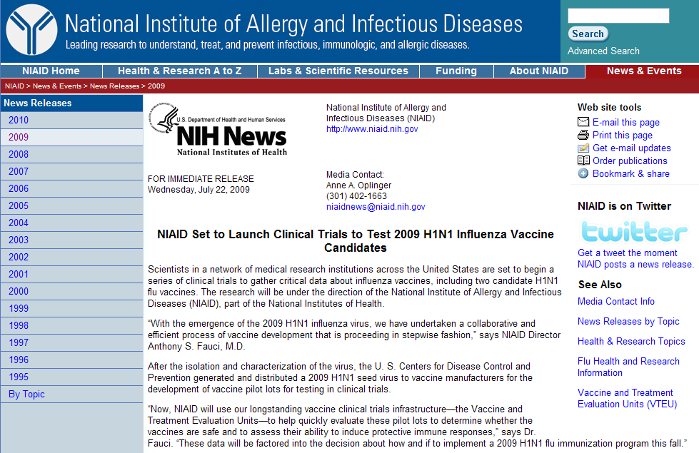
2009 H1N1 Accomplishments
Clinical trials of the vaccine conducted by the National Institutes of Health (NIH) found that one dose of 2009 H1N1 vaccine was enough to provide an effective immune response in people 10 years of age and older, and no significant vaccine-related health concerns from the vaccine were reported
Accomplishments – p15

Slide 64
2009 H1N1 Accomplishments
CDC and FDA enhanced their ability to monitor the safety of the 2009 H1N1 vaccine and detect any potential problems quickly
Existing vaccine safety monitoring systems were strengthened and new ones were implemented
Objectives for Monitoring Vaccine Safety included:
  Identifying clinically significant adverse events following receipt of 2009 H1N1 vaccine in a timely manner
  Rapidly evaluating serious adverse events following receipt of 2009 H1N1 vaccine and determining the public health importance
  Evaluating if there is a risk of Guillain-Barre syndrome (GBS) associated with 2009 H1N1 vaccine and other specified outcomes
  Communicating vaccine safety information in a clear and transparent manner to health care providers, public health officials, and the public
Accomplishments – pXXX

Slide 65
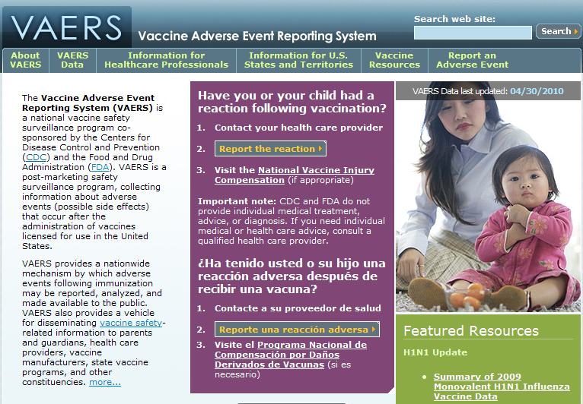
2009 H1N1 Accomplishments
The Vaccine Adverse Event Reporting System (VAERS) is a voluntary reporting system
Jointly managed by CDC and FDA
Identifies potential vaccine safety signs
National in scope
Encourages reports from healthcare providers
Accepts reports from vaccinees and others.
Medical personnel conduct daily reviews of the information collected.
For more information, see http://vaers.hhs.gov.
Accomplishments – p16

Slide 66
2009 H1N1 Accomplishments
VAERS enhancements were made for the 2009 H1N1 vaccines
Enhancements included an increase in staffing to process VAERS reports more rapidly, and an increase in visibility on professional web sites to encourage reporting
As of June 3, 2010…
  About 127 million doses of vaccine had been shipped to vaccine providers in the United States
  VAERS had received 11,180 adverse event reports
  Ninety-two percent were reported as “non-serious” and 7.7% were classified as “serious” health events. This proportion is similar to the seasonal influenza vaccination experience
  One hundred and forty-three reports of Guillian-Barre syndrome (GBS) had been reported. In the United States, an estimated 3,000 to 6,000 people develop GBS each year on average, whether or not they received a vaccination
It’s important to note that VAERS has limitations, including that it cannot assess causality and receives variable quality of data
Accomplishments – pXXX

Slide 67
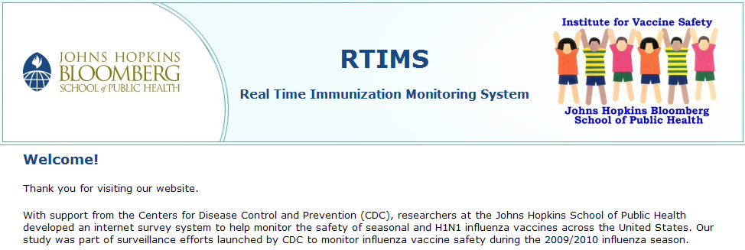
2009 H1N1 Accomplishments
A new Web-based active surveillance system was also implemented to prospectively follow tens of thousands of vaccinated people. For more information, see www.myflushot.org
The vaccine safety data thus far have shown that the 2009 H1N1 vaccine has a safety profile similar to seasonal influenza vaccines
Accomplishments – p17

Slide 68
2009 H1N1 Accomplishments
Communication During the Pandemic
The agency’s mission to protect public health was supported by communications founded on emergency risk communications principles of quickly, proactively and transparently communicating accurate information about the situation
This included clearly stating CDC’s goals and actions in response to the evolving situation and acknowledging what was not known as well as what was known. The goal was to inform the public, but to avoid causing unnecessary fear
From the earliest days of the pandemic, CDC clearly and repeatedly stated its goals to “reduce transmission and illness severity, and to provide information to help health care providers, public health officials and the public address the challenges posed by the new virus.” Communications messages were tempered by the values – Be first, be right, and be credible
Be First
Be Right
Be Credible
Accomplishments – p18

Slide 69

2009 H1N1 Accomplishments
CDC quickly disseminated information to support those stated goals and dozens of communications tools were used to reach out to audiences across the spectrum, from the public to pharmacists to diagnostics experts to international partners and countries around the globe
During the early days of the outbreak especially, the release and exchange of information was conducted on a 24-hour cycle and included frequent updates to media and the public, as well as the consistent use of a body of core spokespersons, daily information outreach to partners, and rapid establishment and daily maintenance of extensive Web content related to the emergency response
Accomplishments – p19

Slide 70
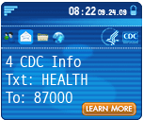


2009 H1N1 Accomplishments
Outlets for outreach included the media, the Internet, health alert networks, outreach through partners and partner organizations, and a 24-hour information hotline, called CDC-INFO
  Throughout the pandemic, CDC-INFO responded to over 212,368 inquiries about 2009 H1N1, including 141,775 general public phone calls, 47,311 general public emails, 23,268 clinician phone calls, and 13 letters
New methods of outreach were utilized, including video Podcasts, YouTube videos, Facebook postings and Twitter to reach out to people using new and emergent technologies
Accomplishments – p20

Slide 71



2009 H1N1 Accomplishments
CDC obtained 55,341 Facebook fans during the pandemic
CDC also shared 2009 H1N1 health information through three Twitter feeds: CDCFlu, CDCEmergency, and CDC_ehealth
There are 1,248,719 Twitter followers for the CDC emergency profile, 33,920 Twitter followers for the CDC_eHealth profile, and 31,338 Twitter followers for the CDCFlu profile
Video Podcasts and YouTube videos featuring CDC Influenza Division subject matter experts received millions of hits and brought the American public and the rest of the world closer to the science of flu and public health than ever before
  2,991,280 Podcasts related to 2009 H1N1 were downloaded
Accomplishments – p21

Slide 72
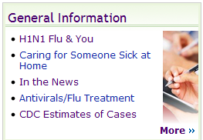
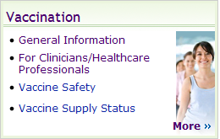

2009 H1N1 Accomplishments
CDC’s 2009 H1N1 influenza website grew from one page to over 200 pages in the first three weeks of the 2009 H1N1 outbreak. The website had received more than 221,388,322 page views since its creation
Key materials and Web pages were translated into multiple languages. For example, the entire English-language 2009 H1N1 site was mirrored in Spanish. In addition, key tools and resources were created in Chinese, Vietnamese, Korean, Japanese, French, German, Arabic, Russian, Amharic, Farsi, Somali, Karen, Burmese, Cambodian and Kirundi
Accomplishments – p22

Slide 73
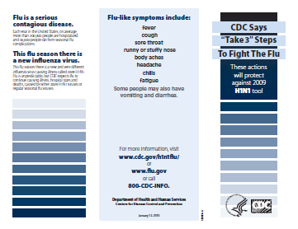
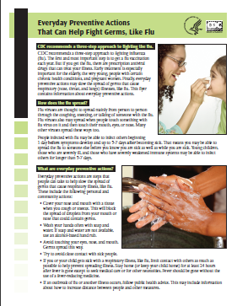
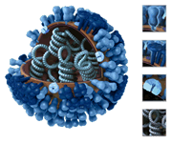
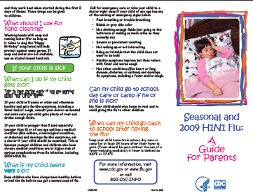
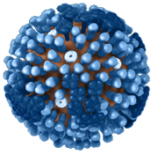
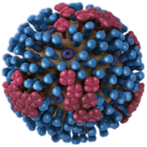
2009 H1N1 Accomplishments
2009 H1N1 related factsheets, flyers and brochures were designed, created and made available throughout the pandemic to different audiences on CDC’s free flu resources webpage (www.cdc.gov/h1n1flu/freeresources.htm)
In addition, new images of the virus were created and posted on the “Images of the H1N1 influenza virus” page www.cdc.gov/h1n1flu/images.htm
Accomplishments – p23

Slide 74


2009 H1N1 Accomplishments
Key messages were developed internally and distributed daily, and later, weekly, to states, partners and affiliates throughout the outbreak response. The first key messages were distributed on April 19, 2009
CDC’s Division of Global Migration and Quarantine managed and implemented a national Travelers’ Health media campaign with messages for healthy travel posted and distributed in over 300 ports of entry to the United States, plus national radio, newspaper and online advertisements with over 80 million exposures
Accomplishments – p24

Slide 75
Where are we now?
During the 2010-2011 flu season, CDC expects the 2009 H1N1 virus to cause illness again along with other influenza viruses
The 2010-2011 flu vaccine is expected to protect against 2009 H1N1 (and an H3N2 virus and an influenza B virus)

Slide 76
What You Can Do
Take time to get a flu vaccine
Take everyday preventive actions to stop the spread of germs
Take flu antiviral drugs if your doctor prescribes them
    http://www.cdc.gov/flu/protect/preventing.htm

Slide 77
Resources
http://www.flu.gov/
http://www.cdc.gov/flu/
http://www.cdc.gov/h1n1flu/
http://www.who.int/csr/disease/swineflu/en/index.html

